Slide 1
Computer Architecture
A Quantitative Approach, Fifth Edition
Chapter 3
Instruction-Level Parallelism and Its Exploitation

Slide 2
Introduction
Introduction
Pipelining become universal technique in 1985
Overlaps execution of instructions
Exploits “Instruction Level Parallelism”
Beyond this, there are two main approaches:
Hardware-based dynamic approaches
Used in server and desktop processors
Not used as extensively in PMP processors
Compiler-based static approaches
Not as successful outside of scientific applications

Slide 3
Instruction-Level Parallelism
Introduction
When exploiting instruction-level parallelism, goal is to maximize CPI
Pipeline CPI =
Ideal pipeline CPI +
Structural stalls +
Data hazard stalls +
Control stalls
Parallelism with basic block is limited
Typical size of basic block = 3-6 instructions
Must optimize across branches

Slide 4
Data Dependence
Introduction
Loop-Level Parallelism
Unroll loop statically or dynamically
Use SIMD (vector processors and GPUs)
Challenges:
Data dependency
Instruction j is data dependent on instruction i if
Instruction i produces a result that may be used by instruction j
Instruction j is data dependent on instruction k and instruction k is data dependent on instruction i
Dependent instructions cannot be executed simultaneously

Slide 5
Data Dependence
Introduction
Dependencies are a property of programs
Pipeline organization determines if dependence is detected and if it causes a stall
Data dependence conveys:
Possibility of a hazard
Order in which results must be calculated
Upper bound on exploitable instruction level parallelism
Dependencies that flow through memory locations are difficult to detect

Slide 6
Name Dependence
Introduction
Two instructions use the same name but no flow of information
Not a true data dependence, but is a problem when reordering instructions
Antidependence: instruction j writes a register or memory location that instruction i reads
Initial ordering (i before j) must be preserved
Output dependence: instruction i and instruction j write the same register or memory location
Ordering must be preserved
To resolve, use renaming techniques

Slide 7
Other Factors
Introduction
Data Hazards
Read after write (RAW)
Write after write (WAW)
Write after read (WAR)
Control Dependence
Ordering of instruction i with respect to a branch instruction
Instruction control dependent on a branch cannot be moved before the branch so that its execution is no longer controller by the branch
An instruction not control dependent on a branch cannot be moved after the branch so that its execution is controlled by the branch

Slide 8
Examples
Introduction
Example 1:
DADDU R1,R2,R3
BEQZ R4,L
DSUBU R1,R1,R6
L: …
OR R7,R1,R8
Example 2:
DADDU R1,R2,R3
BEQZ R12,skip
DSUBU R4,R5,R6
DADDU R5,R4,R9
skip:
OR R7,R8,R9
OR instruction dependent on DADDU and DSUBU
Assume R4 isn’t used after skip
Possible to move DSUBU before the branch

Slide 9
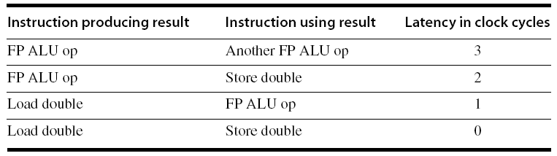
Compiler Techniques for Exposing ILP
Compiler Techniques
Pipeline scheduling
Separate dependent instruction from the source instruction by the pipeline latency of the source instruction
Example:
for (i=999; i>=0; i=i-1)
x[i] = x[i] + s;

Slide 10
Pipeline Stalls
Compiler Techniques
Loop: L.D F0,0(R1)
stall
ADD.D F4,F0,F2
stall
stall
S.D F4,0(R1)
DADDUI R1,R1,#-8
stall (assume integer load latency is 1)
BNE R1,R2,Loop

Slide 11
Pipeline Scheduling
Compiler Techniques
Scheduled code:
Loop: L.D F0,0(R1)
DADDUI R1,R1,#-8
ADD.D F4,F0,F2
stall
stall
S.D F4,8(R1)
BNE R1,R2,Loop

Slide 12
Loop Unrolling
Compiler Techniques
A simple scheme for increasing the number of instructions relative to the branch and overhead instructions is loop unrolling.
Unrolling simply replicates the loop body multiple times, adjusting the loop termination code

Slide 13
Loop Unrolling
Compiler Techniques
Loop unrolling
Unroll by a factor of 4 (assume # elements is divisible by 4)
Eliminate unnecessary instructions
Loop: L.D F0,0(R1)
ADD.D F4,F0,F2
S.D F4,0(R1) ;drop DADDUI & BNE
L.D F6,-8(R1)
ADD.D F8,F6,F2
S.D F8,-8(R1) ;drop DADDUI & BNE
L.D F10,-16(R1)
ADD.D F12,F10,F2
S.D F12,-16(R1) ;drop DADDUI & BNE
L.D F14,-24(R1)
ADD.D F16,F14,F2
S.D F16,-24(R1)
DADDUI R1,R1,#-32
BNE R1,R2,Loop
note: number of live registers vs. original loop
this loop will run in 27 clock cycles—each LD has 1 stall, each ADDD 2, the DADDUI 1, plus 14 instruction issue cycles—or 6.75 clock cycles for each of the four elements

Slide 14
Loop Unrolling/Pipeline Scheduling
Compiler Techniques
Pipeline schedule the unrolled loop:
Loop: L.D F0,0(R1)
L.D F6,-8(R1)
L.D F10,-16(R1)
L.D F14,-24(R1)
ADD.D F4,F0,F2
ADD.D F8,F6,F2
ADD.D F12,F10,F2
ADD.D F16,F14,F2
S.D F4,0(R1)
S.D F8,-8(R1)
DADDUI R1,R1,#-32
S.D F12,16(R1)
S.D F16,8(R1)
BNE R1,R2,Loop
The execution time of the unrolled loop has dropped to a total of 14 clock cycles, or 3.5 clock cycles per element

Slide 15
Strip Mining
Compiler Techniques
Unknown number of loop iterations?
Number of iterations = n
Goal: make k copies of the loop body
Generate pair of loops:
First executes n mod k times
Second executes n / k times
“Strip mining”

Slide 16
Branch Prediction
Branch Prediction
Basic 2-bit predictor:
For each branch:
Predict taken or not taken
If the prediction is wrong two consecutive times, change prediction
Correlating predictor:
Multiple 2-bit predictors for each branch
One for each possible combination of outcomes of preceding n branches
Local predictor:
Multiple 2-bit predictors for each branch
One for each possible combination of outcomes for the last n occurrences of this branch
Tournament predictor:
Combine correlating predictor with local predictor

Slide 17
Correlating predictor:
Branch predictors that use the behavior of other branches to make a prediction are called correlating predictors or two-level predictors.
if (aa==2) aa=0;
if (bb==2) bb=0;
if (aa!=bb)
Let’s label these branches b1, b2, and b3. The key observation is that the behavior of branch b3 is correlated with the behavior of branches b1 and b2. Clearly, if branches b1 and b2 are both not taken (i.e., if the conditions both evaluate to true and aa and bb are both assigned 0), then b3 will be taken, since aa and bb are clearly equal.

Slide 18
2m × n × Number of prediction entries selected by the branch address
How many bits are in the (0,2) branch predictor with 4K entries? How many entries are in a (2,2) predictor with the same number of bits?
Answer The predictor with 4K entries has 20 × 2 × 4K = 8K bits

Slide 19
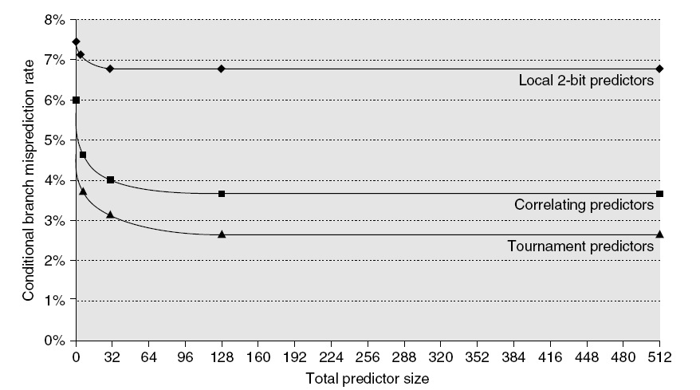
Branch Prediction Performance
Branch Prediction
Branch predictor performance

Slide 20
Dynamic Scheduling
Branch Prediction
Rearrange order of instructions to reduce stalls while maintaining data flow
Run time, H/W
Advantages:
Compiler doesn’t need to have knowledge of microarchitecture
Handles cases where dependencies are unknown at compile time
Disadvantage:
Substantial increase in hardware complexity
Complicates exceptions

Slide 21
Dynamic Scheduling
Branch Prediction
Dynamic scheduling implies:
Out-of-order execution
Out-of-order completion
Creates the possibility for WAR and WAW hazards
Tomasulo’s Approach
Tracks when operands are available
Introduces register renaming in hardware
Minimizes WAW and WAR hazards

Slide 22
Register Renaming
Branch Prediction
Example:
DIV.D F0,F2,F4
ADD.D F6,F0,F8
S.D F6,0(R1)
SUB.D F8,F10,F14
MUL.D F6,F10,F8
+ name dependence with F6
antidependence
antidependence

Slide 23
Register Renaming
Branch Prediction
Example:
DIV.D F0,F2,F4
ADD.D S,F0,F8
S.D S,0(R1)
SUB.D T,F10,F14
MUL.D F6,F10,T
Now only RAW hazards remain, which can be strictly ordered

Slide 24
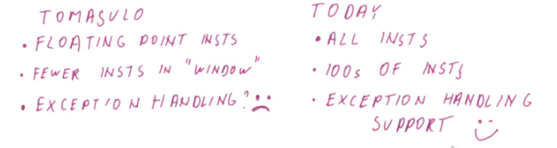
Tomasulo’s Algorithm
One of the First technique for out of order execution
Used IBM 360 Machine
Determine which instruction are ready sothat they can go in next cycle and which instruction still has to wait there inputs to be produce,
It also includes the form of register renaming

Slide 25
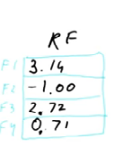
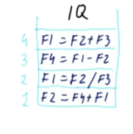
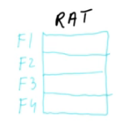
ISSUE Example: How TA works?

Slide 26
Register Renaming
Branch Prediction
Register renaming is provided by reservation stations (RS)
Contains:
The instruction
Buffered operand values (when available)
Reservation station number of instruction providing the operand values
RS fetches and buffers an operand as soon as it becomes available (not necessarily involving register file)
Pending instructions designate the RS to which they will send their output
Result values broadcast on a result bus, called the common data bus (CDB)
Only the last output updates the register file
As instructions are issued, the register specifiers are renamed with the reservation station
May be more reservation stations than registers

Slide 27
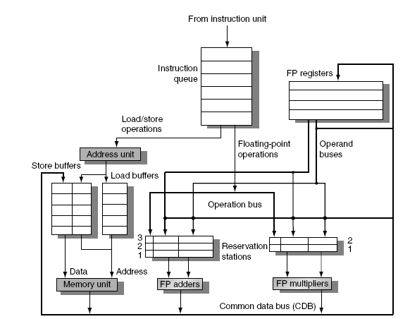
Tomasulo’s Algorithm
Branch Prediction
Load and store buffers
Contain data and addresses, act like reservation stations
Top-level design:

Slide 28
Tomasulo’s Algorithm
Branch Prediction
Three Steps:
Issue
Get next instruction from FIFO queue
If available RS, issue the instruction to the RS with operand values if available
If operand values not available, stall the instruction
Execute
When operand becomes available, store it in any reservation stations waiting for it
When all operands are ready, issue the instruction
Loads and store maintained in program order through effective address
No instruction allowed to initiate execution until all branches that proceed it in program order have completed
Write result
Write result on CDB into reservation stations and store buffers
(Stores must wait until address and value are received)

Slide 29
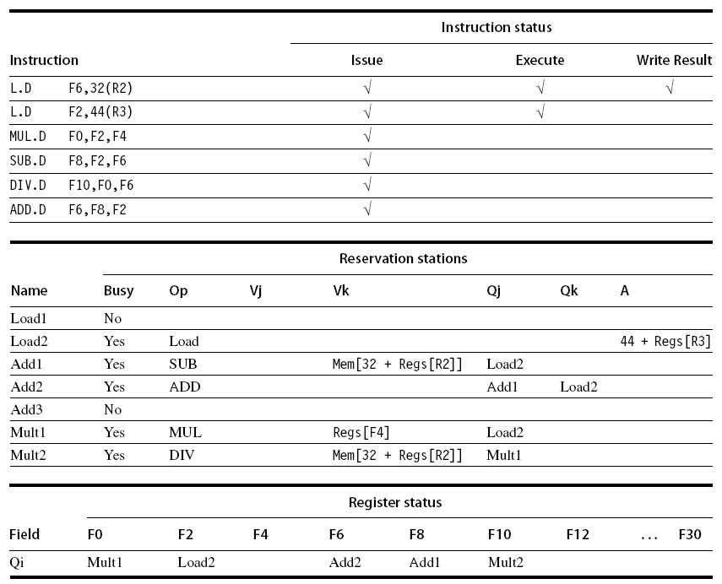
Example
Branch Prediction

Slide 30
Hardware-Based Speculation
Branch Prediction
Execute instructions along predicted execution paths but only commit the results if prediction was correct
Instruction commit: allowing an instruction to update the register file when instruction is no longer speculative
Need an additional piece of hardware to prevent any irrevocable action until an instruction commits
I.e. updating state or taking an execution

Slide 31
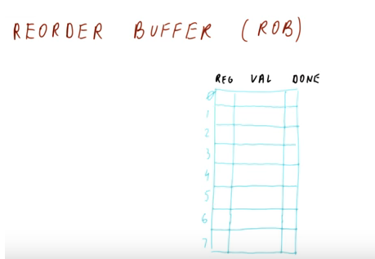
Reorder Buffer
Branch Prediction
Reorder buffer – holds the result of instruction between completion and commit

Slide 32
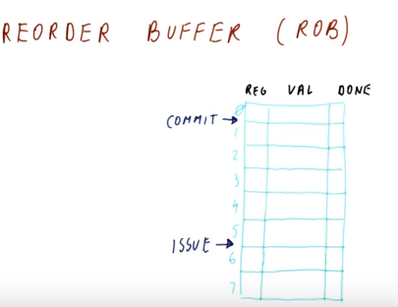
Reorder Buffer
Branch Prediction

Slide 33
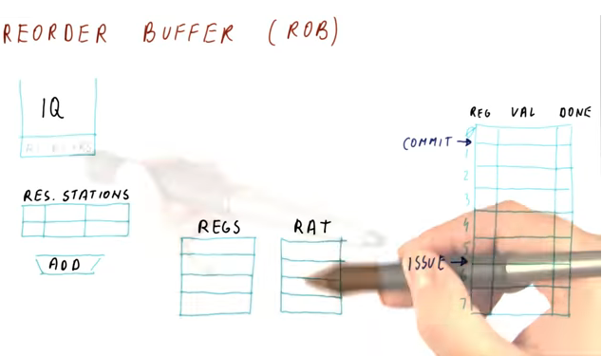
Reorder Buffer
Branch Prediction

Slide 34
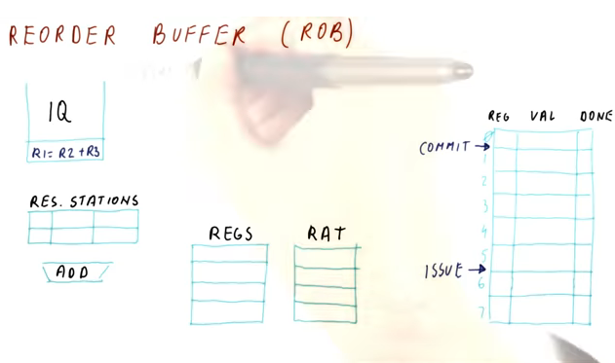
Reorder Buffer
Branch Prediction

Slide 35
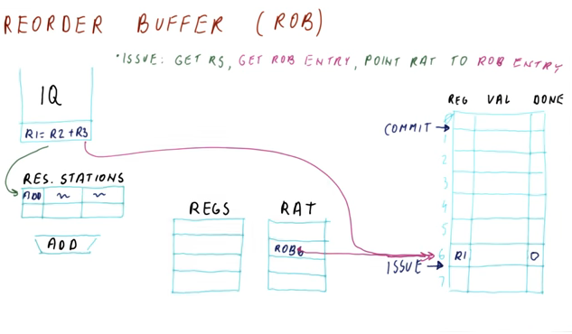
Reorder Buffer
Branch Prediction

Slide 36
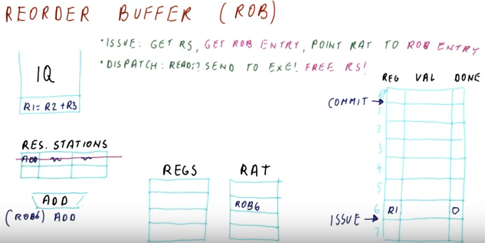
Reorder Buffer
Branch Prediction

Slide 37
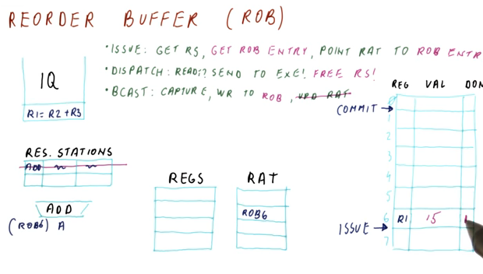
Reorder Buffer
Branch Prediction

Slide 38
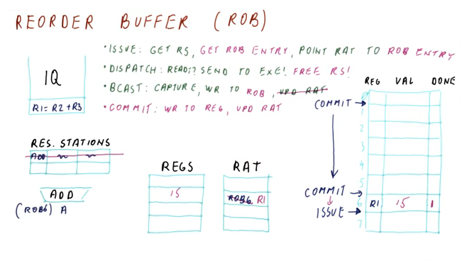
Reorder Buffer

Slide 39
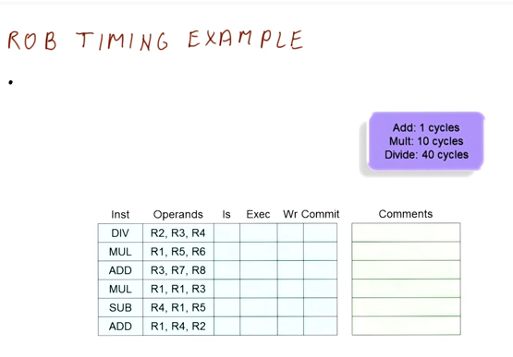

Slide 40
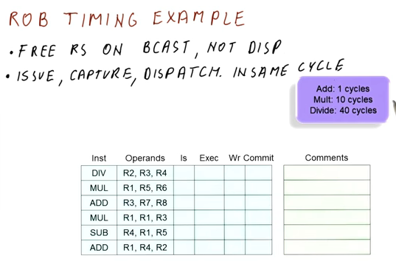

Slide 41
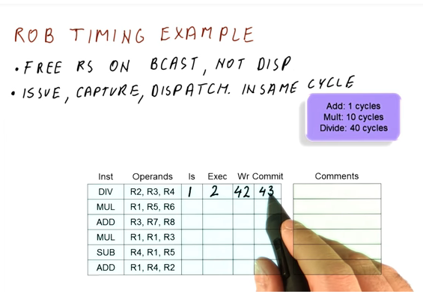

Slide 42
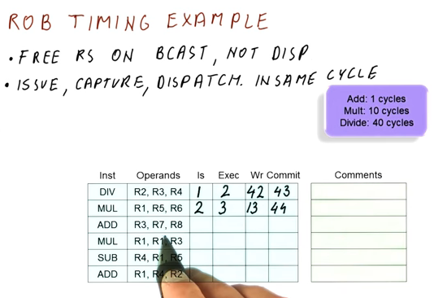

Slide 43
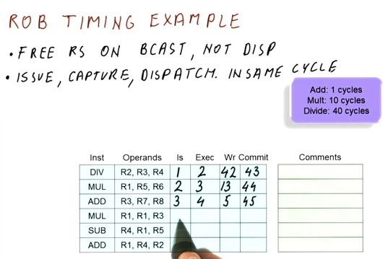

Slide 44
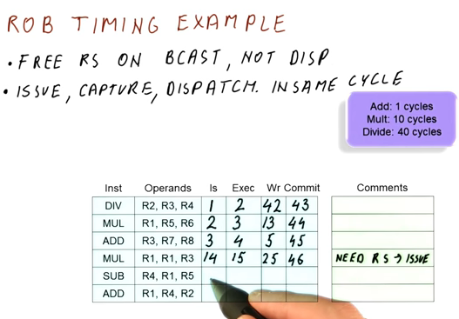

Slide 45
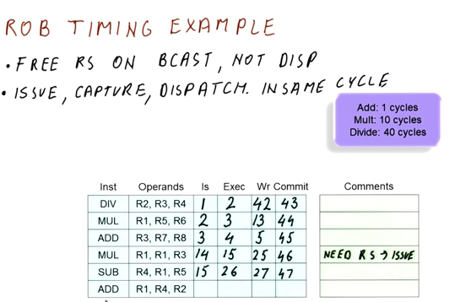

Slide 46
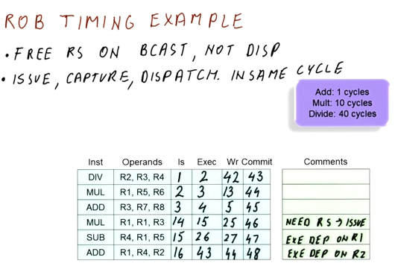

Slide 47
Reorder Buffer
Branch Prediction
Register values and memory values are not written until an instruction commits
On misprediction:
Speculated entries in ROB are cleared
Exceptions:
Not recognized until it is ready to commit

Slide 48
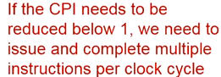
Multiple Issue and Static Scheduling
To achieve CPI < 1, need to complete multiple instructions per clock
Solutions:
Statically scheduled superscalar processors
VLIW (very long instruction word) processors
dynamically scheduled superscalar processors
Multiple Issue and Static Scheduling

Slide 49
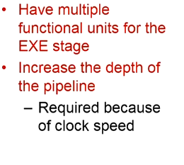
Multiple Issue and Static Scheduling
Multiple Issue and Static Scheduling

Slide 50
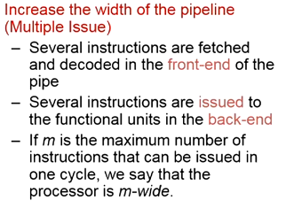
Multiple Issue and Static Scheduling
Multiple Issue and Static Scheduling

Slide 51
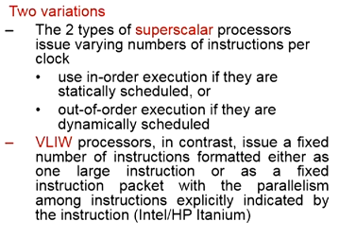
Multiple Issue and Static Scheduling
Multiple Issue and Static Scheduling

Slide 52
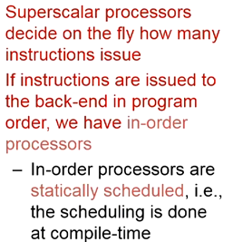
Multiple Issue and Static Scheduling
Multiple Issue and Static Scheduling

Slide 53
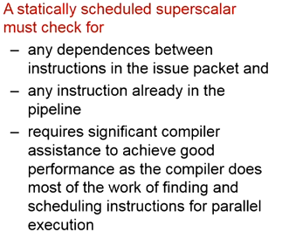
Multiple Issue and Static Scheduling
Multiple Issue and Static Scheduling

Slide 54
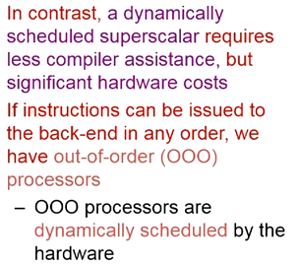
Multiple Issue and Static Scheduling
Multiple Issue and Static Scheduling

Slide 55
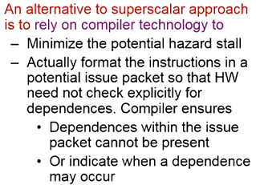

Slide 56
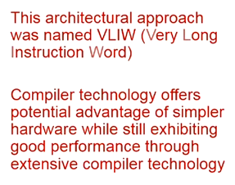
VLIW

Slide 57
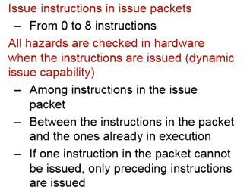
Multiple Issue and Static Scheduling

Slide 58
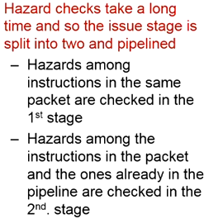
Multiple Issue and Static Scheduling

Slide 59
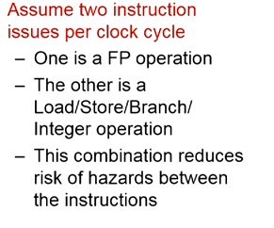
Multiple Issue and Static Scheduling

Slide 60
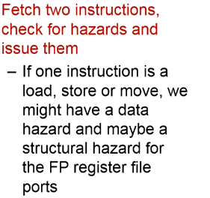
Multiple Issue and Static Scheduling

Slide 61
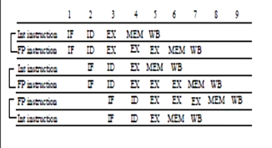

Slide 62
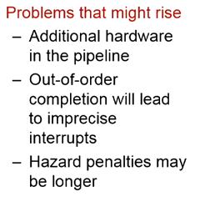

Slide 63
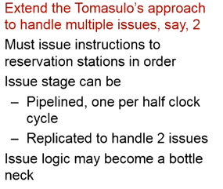
Multiple Issue and Dynmaic Scheduling

Slide 64
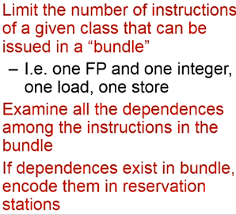
Multiple Issue and Dynmaic Scheduling

Slide 65
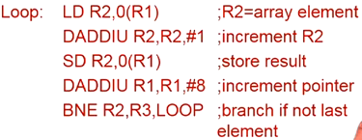
Example

Slide 66
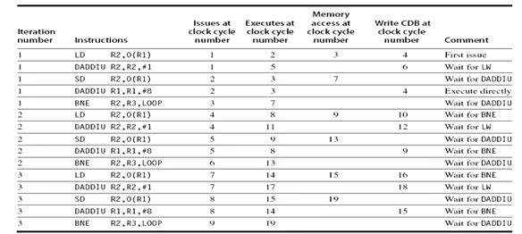
Example(no Speculation)

Slide 67
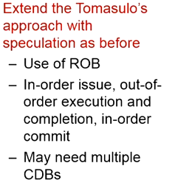
Speculation

Slide 68
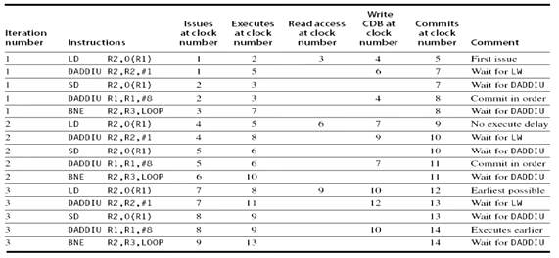
Example(with speculation)

Slide 69
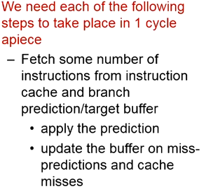
Multiple issue

Slide 70
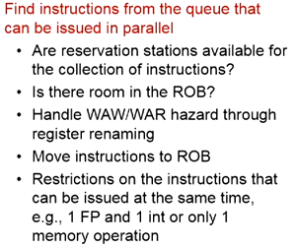
Multiple issue

Slide 71
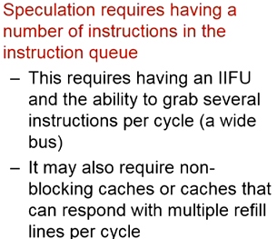
Multiple issue

Slide 72
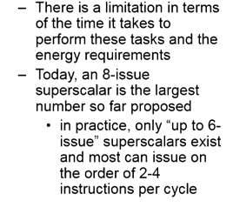
Multiple issue

Slide 73
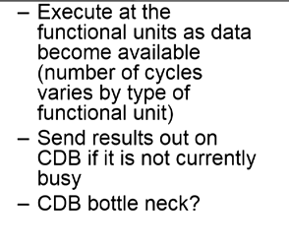
Multiple issue

Slide 74

Multiple issue

Slide 75

Multiple issue

Slide 76

Multiple issue

Slide 77

Multiple issue

Slide 78

Multiple issue

Slide 79

Multiple issue

Slide 80

Multiple issue

Slide 81

Summary

Slide 82

Summary

Slide 83

Summary

Slide 84

Multiple Issue
Multiple Issue and Static Scheduling

Slide 85

VLIW

Slide 86

VLIW

Slide 87

VLIW

Slide 88

VLIW

Slide 89

VLIW

Slide 90

VLIW

Slide 91

VLIW

Slide 92

VLIW

Slide 93

VLIW

Slide 94


Slide 95


Slide 96


Slide 97


Slide 98


Slide 99


Slide 100


Slide 101


Slide 102


Slide 103


Slide 104


Slide 105


Slide 106


Slide 107


Slide 108


Slide 109


Slide 110


Slide 111


Slide 112


Slide 113


Slide 114
VLIW Processors
Package multiple operations into one instruction
Example VLIW processor:
One integer instruction (or branch)
Two independent floating-point operations
Two independent memory references
Must be enough parallelism in code to fill the available slots
Multiple Issue and Static Scheduling

Slide 115
VLIW Processors
Disadvantages:
Statically finding parallelism
Code size
No hazard detection hardware
Binary code compatibility
Multiple Issue and Static Scheduling

Slide 116
Dynamic Scheduling, Multiple Issue, and Speculation
Modern microarchitectures:
Dynamic scheduling + multiple issue + speculation
Two approaches:
Assign reservation stations and update pipeline control table in half clock cycles
Only supports 2 instructions/clock
Design logic to handle any possible dependencies between the instructions
Hybrid approaches
Issue logic can become bottleneck
Dynamic Scheduling, Multiple Issue, and Speculation

Slide 117

Overview of Design
Dynamic Scheduling, Multiple Issue, and Speculation

Slide 118
Multiple Issue
Limit the number of instructions of a given class that can be issued in a “bundle”
I.e. on FP, one integer, one load, one store
Examine all the dependencies amoung the instructions in the bundle
If dependencies exist in bundle, encode them in reservation stations
Also need multiple completion/commit
Dynamic Scheduling, Multiple Issue, and Speculation

Slide 119
Example
Loop: LD R2,0(R1) ;R2=array element
DADDIU R2,R2,#1 ;increment R2
SD R2,0(R1) ;store result
DADDIU R1,R1,#8 ;increment pointer
BNE R2,R3,LOOP ;branch if not last element
Dynamic Scheduling, Multiple Issue, and Speculation

Slide 120

Example (No Speculation)
Dynamic Scheduling, Multiple Issue, and Speculation

Slide 121

Example
Dynamic Scheduling, Multiple Issue, and Speculation

Slide 122


Branch-Target Buffer
Need high instruction bandwidth!
Branch-Target buffers
Next PC prediction buffer, indexed by current PC
Adv. Techniques for Instruction Delivery and Speculation

Slide 123
Branch Folding
Optimization:
Larger branch-target buffer
Add target instruction into buffer to deal with longer decoding time required by larger buffer
“Branch folding”
Adv. Techniques for Instruction Delivery and Speculation

Slide 124
Return Address Predictor
Most unconditional branches come from function returns
The same procedure can be called from multiple sites
Causes the buffer to potentially forget about the return address from previous calls
Create return address buffer organized as a stack
Adv. Techniques for Instruction Delivery and Speculation

Slide 125
Integrated Instruction Fetch Unit
Design monolithic unit that performs:
Branch prediction
Instruction prefetch
Fetch ahead
Instruction memory access and buffering
Deal with crossing cache lines
Adv. Techniques for Instruction Delivery and Speculation

Slide 126
Register Renaming
Register renaming vs. reorder buffers
Instead of virtual registers from reservation stations and reorder buffer, create a single register pool
Contains visible registers and virtual registers
Use hardware-based map to rename registers during issue
WAW and WAR hazards are avoided
Speculation recovery occurs by copying during commit
Still need a ROB-like queue to update table in order
Simplifies commit:
Record that mapping between architectural register and physical register is no longer speculative
Free up physical register used to hold older value
In other words: SWAP physical registers on commit
Physical register de-allocation is more difficult
Adv. Techniques for Instruction Delivery and Speculation

Slide 127
Integrated Issue and Renaming
Combining instruction issue with register renaming:
Issue logic pre-reserves enough physical registers for the bundle (fixed number?)
Issue logic finds dependencies within bundle, maps registers as necessary
Issue logic finds dependencies between current bundle and already in-flight bundles, maps registers as necessary
Adv. Techniques for Instruction Delivery and Speculation

Slide 128
How Much?
How much to speculate
Mis-speculation degrades performance and power relative to no speculation
May cause additional misses (cache, TLB)
Prevent speculative code from causing higher costing misses (e.g. L2)
Speculating through multiple branches
Complicates speculation recovery
No processor can resolve multiple branches per cycle
Adv. Techniques for Instruction Delivery and Speculation

Slide 129
Energy Efficiency
Speculation and energy efficiency
Note: speculation is only energy efficient when it significantly improves performance
Value prediction
Uses:
Loads that load from a constant pool
Instruction that produces a value from a small set of values
Not been incorporated into modern processors
Similar idea--address aliasing prediction--is used on some processors
Adv. Techniques for Instruction Delivery and Speculation

